Slide 1
Software Development with UML and Java 2

Slide 2
Agenda
Sockets
Threads

Slide 3
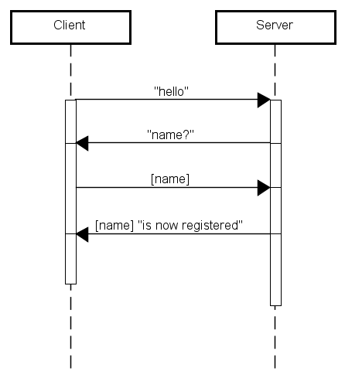
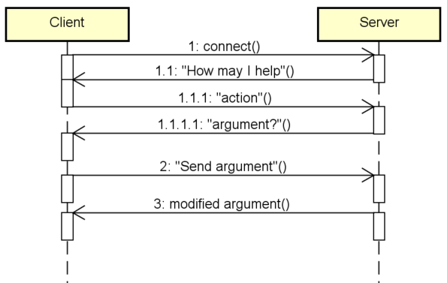
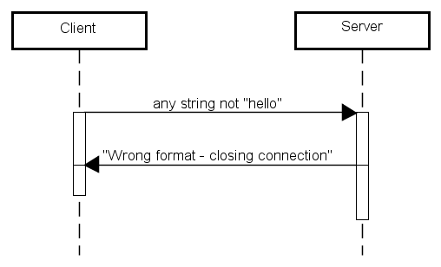
Protocol Design
Which protocol for client/server communication?
You have to draw the diagrams for communication flow – no matter which communication protocol you may decide to follow

Slide 4
Sockets
Server
Client

Slide 5
Sockets
Client
Server
Client
Client

Slide 6
Sockets, simple example
Client
Server
MESSAGE
Message

Slide 7
Sockets, simple chat
Client
Server
Message
Client
Client

Slide 8
Sockets, simple chat
Client
Server
MESSAGE
MESSAGE
Client
MESSAGE
Client

Slide 9



Slide 11







Slide 21
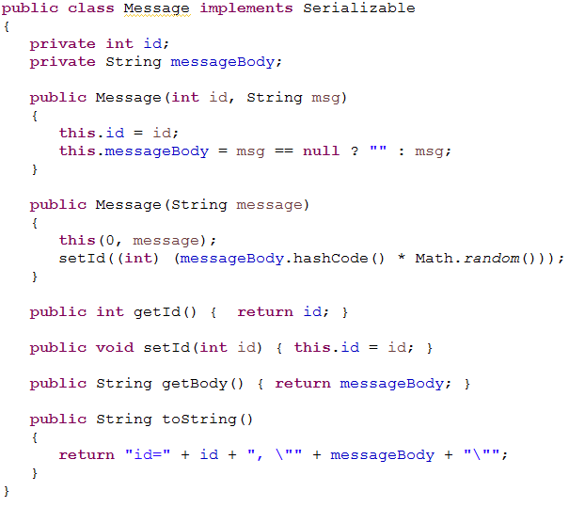
Sending and receiving (serialized) objects
Must implement Serializable

Slide 22
What can we send through sockets?
Simple types
Strings
Objects
Anything that is Serializable
Must implement the interface
Collections

Slide 23
Last time
If you run the server, then multiple clients, the server handles one client at a time. But we want to be able to handle multiple threads
Running several applications from Eclipse → remember to close them all again!

Slide 24


Slide 25

A chat system
A chat system with sockets, one server, multiple clients.
Previous example, this code halts the program and waits for the user:

Slide 26
Threaded Echo server
We need to be able to handle multiple connections at once → Threads
Each new connected client will be handled in a different thread.
Socket connectionSocket = welcomeSocket.accept();
ServerConnection c = new ServerConnection(connectionSocket);
new Thread(c, "Communication ").start();
My Runnable class
Just a name

Slide 27
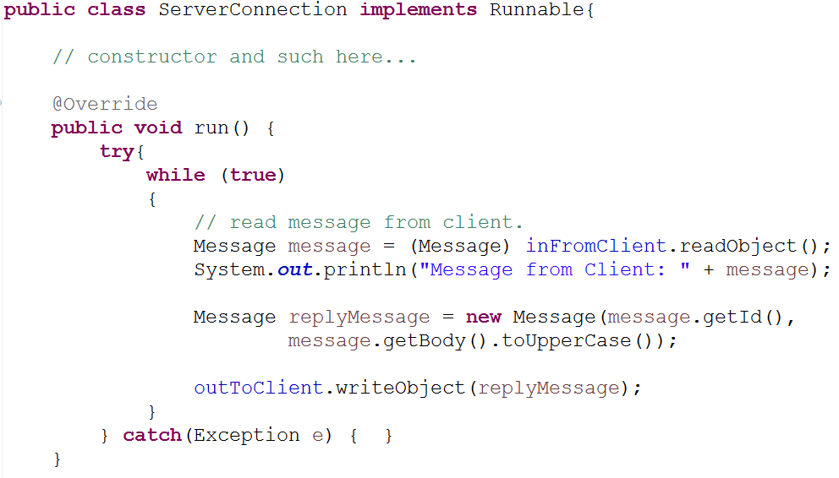
ServerConnection
Contructor takes a Socket, creates input and output streams as field variables
Instead of just upper casing it, we could call a method on the Server.
Notes:
Instead of the main method handling client connections, this is done in a thread → ServerConnection. That means the main method is not blocked for other client connections.

Slide 28
ServerConnection
Client 1
Client 2
Client 3
Server
Notes:
Instead of the main method handling client connections, this is done in a thread → ServerConnection. That means the main method is not blocked for other client connections.

Slide 29
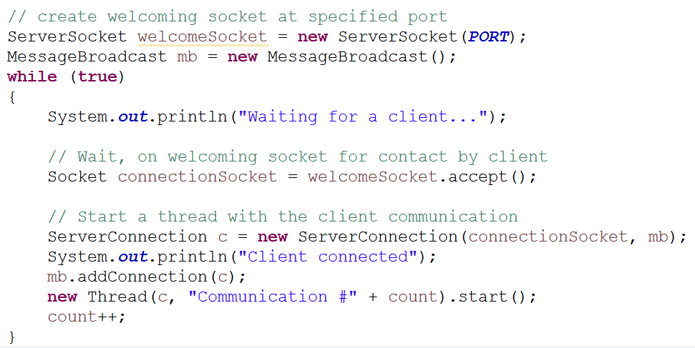
The new server main method

Slide 30
What happens?
Server
Threads
Client
Client
Notes:
The server is running. A client connects, and the server handles that in a separate thread. Then another client connects, and a new thread is started for that client.

Slide 31


Slide 32
The previous example was just an echo
In a chat system, it would be nice to be able to chat with others.
How do we do that?

Slide 33
The previous example was just an echo
In a chat system, it would be nice to be able to chat with others.
How do we do that?
Whenever the server-thread receives a message from a user, that message must be broadcast to other clients.
Create a class that holds all existing connections

Slide 34
Multiple Clients Diagram
This could just be a list of ServerConnections
Connection pool
Server
ClientA
Notes:
A client connects to a server. The connection is stored in a connection pool, just a class with a list of all current connections. A new thread is created to handle the connection

Slide 35
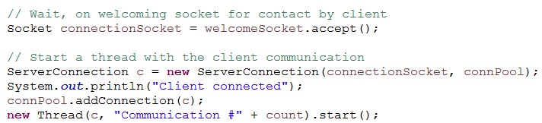
Multiple Clients Diagram
Connection pool
Server
ClientA
Notes:
A client connects to a server. The connection is stored in a connection pool, just a class with a list of all current connections. A new thread is created to handle the connection

Slide 36
Multiple Clients Diagram
Connection pool
Server
ClientA
Notes:
A client connects to a server. The connection is stored in a connection pool, just a class with a list of all current connections. A new thread is created to handle the connection

Slide 37
Connection pool
Server
ClientA
ClientB

Slide 38
Connection pool
Server
ClientA
ClientB
ClientC
Notes:
Three clients are now connected to the server. All connections are stored in the Connection pool.

Slide 39
Connection pool
Server
All threads on the server
ClientA
ClientB
ClientC
Notes:
ClientA sends a message. The message is distributed to ClientB and ClientC via the Connection pool.

Slide 40


Slide 41
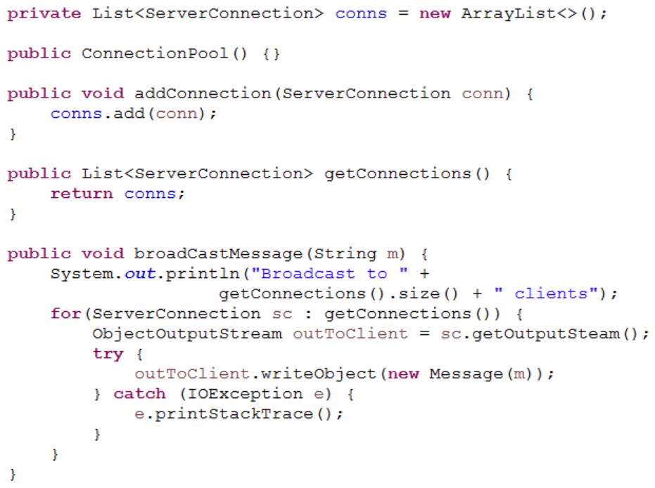
ConnectionPool class

Slide 42
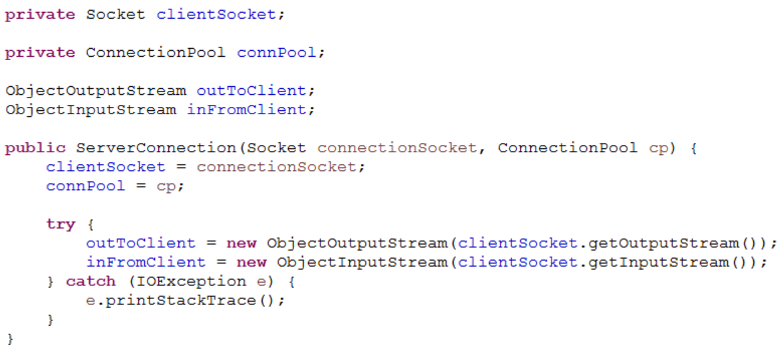
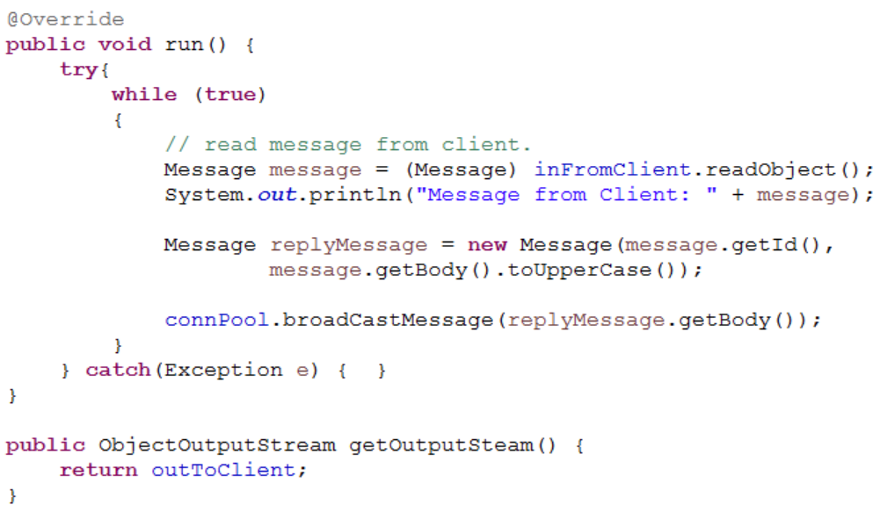
ServerConnection class

Slide 44
Sockets, simple chat
Client
Server
MESSAGE
MESSAGE
Client
MESSAGE
Client

Slide 45


Slide 46
Two SocketHandlers
We need a SocketHandler thread on the server side to handle multiple clients
Usually we also want a SocketHandler on the client side.
If we don’t, then the client side is blocked until we get a response back from the server.
Sometimes calls to the server can take a long time, and we don’t want the user wondering whether the system is stuck or just slow.
If we have a client side SocketHandler, the user can send away a request, then keep working with the program, and at some point an update will come from the server.

Slide 47
Exercise today
Connect to server, receive an ID (client number)
Send requests to the server
Listen for response from the server, but don’t block.

Slide 48
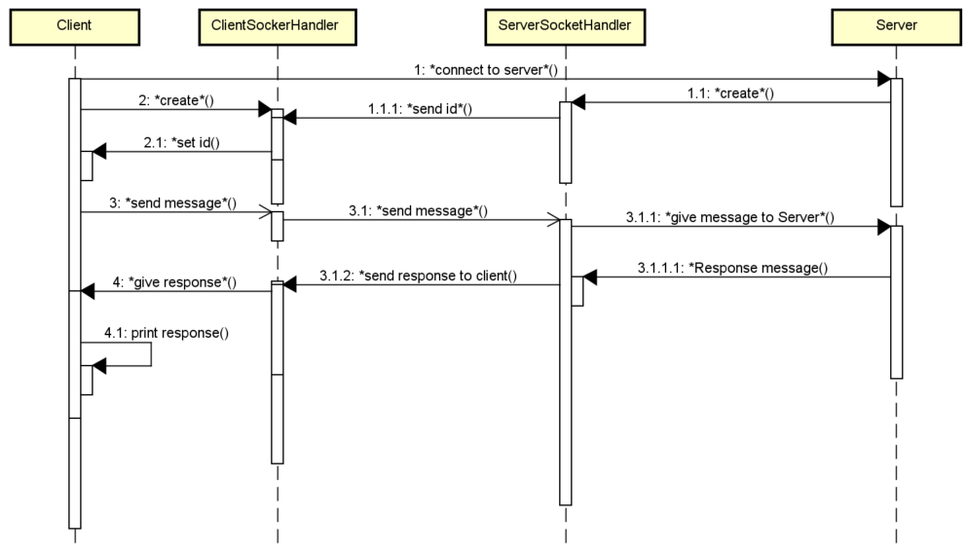
Connection
Connect to server, receive an ID (client number)
Send requests to the server
Listen for response from the server, but don’t block.
Client does something with response

Slide 49
Connection
Connect to server, receive an ID (client number)
Send requests to the server
Listen for response from the server, but don’t block.
Client does something with response

Slide 50
Connection
Connect to server, receive an ID (client number)
Send requests to the server
Listen for response from the server, but don’t block.
Client does something with response

Slide 51
Connection
Connect to server, receive an ID (client number)
Send requests to the server
Listen for response from the server, but don’t block.
Client does something with response

Slide 52
Connection
Connect to server, receive an ID (client number)
Send requests to the server
Listen for response from the server, but don’t block.
Client does something with response

Slide 54
Who’s here?

Slide 55
Today’s Exercises
Simple chat system

